Slide 1



Apache Spark on AWS EC2 use case for NLP exercise: Amazon comments mining
Data Science Warsaw Meetup
Presented by: Sergiy Tkachuk
Date: 12.02.2019

Slide 2
Agenda
1
2
3
Problem statement
Data description
Architecture
4
5
6
Cost efficiency
ML approach
Summary

Slide 3



Education and professional background
Introduction
Data scientist
Business Intelligence Specialist
Reporting Specialist
Database Specialist
Analytics Intern
Master’s degree, Advanced Analytics – Big Data
Bachelor’s degree, Quantitative Methods in Economics and Information Systems

Slide 4
Master thesis inspiration
1
Problem statement
“The use of natural language processing for predictive purposes in socio-economic applications”
Most common commercial utilization of NLP
Conversational systems
Chatbots
Speech recognition
Voice-driven systems
Machine translation (MT)
Neural MT
Google Translator
Microsoft Translator
Text analytics
Social media analysis
Sentiment analysis
Summarization
Text correction
Spelling correction
Style/grammar checking

Slide 5
Books reviews on amazon.com
2
Data description
5-core dataset - subset of the data in which all users and items have at least 5 reviews
{
"reviewerID": "A2SUAM1J3GNN3B",
"asin": "0000013714",
"reviewerName": "J. McDonald",
"helpful": [2, 3],
"reviewText": "I bought this for my husband who plays the piano. He is having a wonderful time playing these old hymns. The music is at times hard to read because we think the book was published for singing from more than playing from. Great purchase though!",
"overall": 5.0,
"summary": "Heavenly Highway Hymns",
"unixReviewTime": 1252800000,
"reviewTime": "09 13, 2009"
}
Data
9.9 GB
41.13 M (reviews)
Metadata
3.1 GB
9.4 M (products)

Slide 6









Building blocks architecture
3
Architecture
Create bucket in the same region
…
IAM
Amazon EC2
Amazon S3

Slide 7
Setting up infrastructure (code snippet)
3
Architecture
Repository for the entire project: https://github.com/tkachuksergiy/aws-spark-nlp
sudo apt-get update
sudo apt-get -y install openjdk-8-jre-headless
sudo apt-get -y install scala
wget https://www-eu.apache.org/dist/spark/spark-2.3.2/spark-2.3.2-bin-hadoop2.7.tgz -P ~/Downloads
sudo tar zxvf ~/Downloads/spark-2.3.2-bin-hadoop2.7.tgz -C /usr/local
…

Slide 8
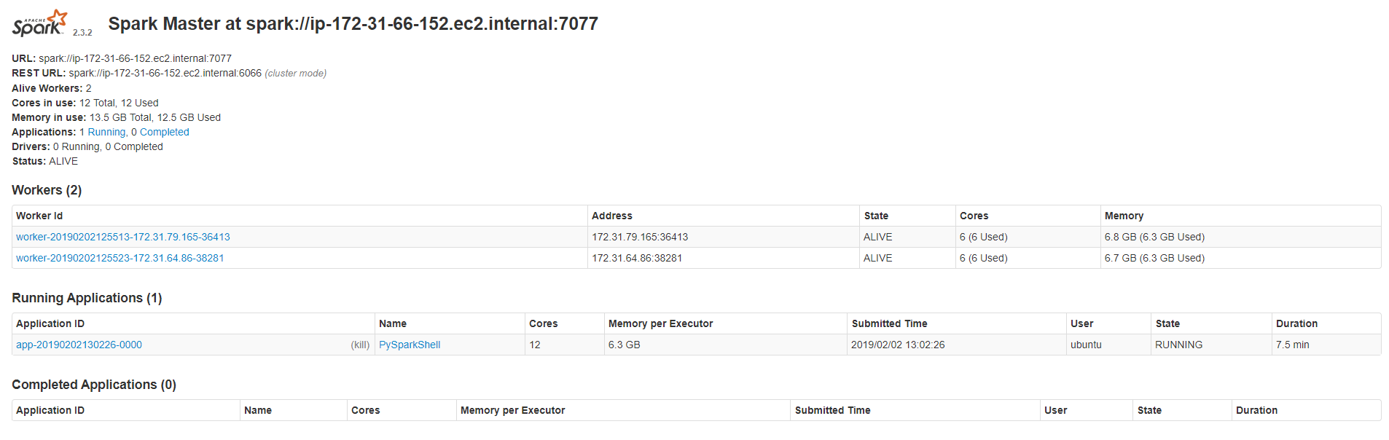
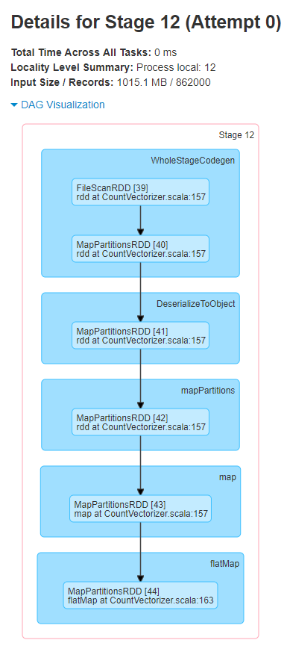
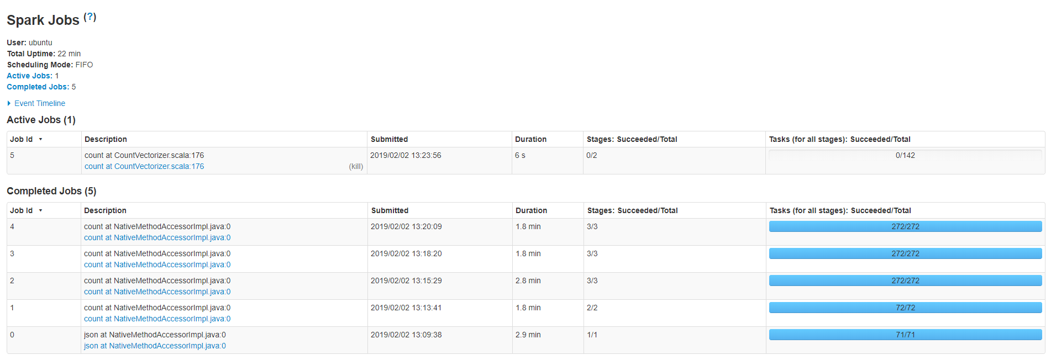
Apache Spark UI
3
Architecture

Slide 9
EC2 spot or on demand? Or maybe EMR?
4
Cost efficiency
Estimation for N.Virginia region
EMR Spark
EC2 on demand
EC2 (spot)
m4.2xlarge
3 instances
4h/day
~ 1.59$/h
Total monthly:
$190.3
m4.2xlarge
3 instances
4h/day
~ 1.22$/h
Total monthly:
$146.4
m4.2xlarge
3 instances
4h/day
~ 0.35$/h
Total monthly:
$42.2
~70%
saving on using spot instances
Amazon EC2 Spot Instances offer spare compute capacity available in the AWS cloud.
Do it yourself ☺

Slide 10

Machine learning scenario
5
ML approach
LR
Naïve Bayes
SVM
PySpark & Spark MLlib
Feature 1
Feature 2
Feature 3
…
Exploratory data analysis
Feature engineering pipeline
Feature selection
Model selection
Prediction

Slide 11
Read in the data (code snippet)
5
ML approach
s3 = boto3.resource('s3’)
bucket = s3.Bucket(‘bucket-name’)
object_list = [k for k in bucket.objects.all() ]
key_list = [k.key for k in bucket.objects.all()]
paths = ['s3a://' + o.bucket_name+'/' + o.key for o in object_list]
path_reviews = paths[0]
data = sqlContext.read.json(path_reviews)
data.createOrReplaceTempView("data")
path_metadata = paths[1]
metadata = spark.read.json(path_metadata)
metadata.createOrReplaceTempView("metadata")
n = data.count()
n_distinct = data.distinct().count()
users = data.select([c for c in data.columns if c == 'reviewerID'])
books = data.select([c for c in data.columns if c == 'asin']).distinct().count()
print('Liczba obserwacji: {0}'.format(n))
print('Liczba unikatowych obserwacji: {0}'.format(n_distinct))
print('Liczba duplikatów: {0}'.format(n - n_distinct))
print('Liczba użytkowników: {0}'.format(users))
print('Liczba książek: {0}'.format(books))

Slide 12
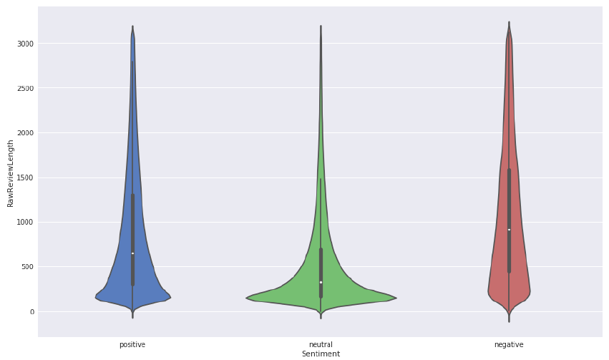

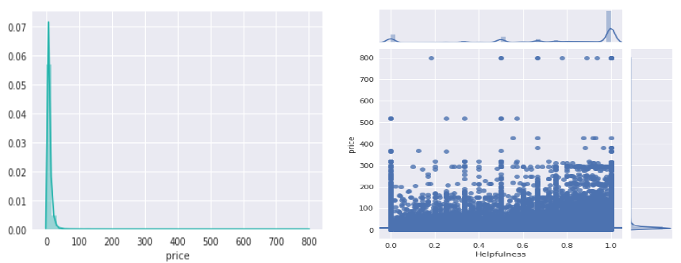

Exploratory data analysis
5
ML approach
Sentiment extraction using VADER* algorithm within NLTK library

Slide 13
Text feature engineering pipeline
5
ML approach
Spark ‘lazy evaluation’
SQL Transformer
Regex Tokenizer
Count Vectorizer
Stop Words Remover
IDF

Slide 14
Text feature engineering pipeline (code snippet)
5
ML approach
Spark ‘lazy evaluation’
sqlTransform = SQLTransformer(statement="SELECT *, concat(summary, ' ', reviewText) as text, concat(asin, ' ', reviewerID) as ID FROM __THIS__")
tokenizer = RegexTokenizer(inputCol="text", outputCol="tokens", pattern="[^\\p{L}]")
stopremover = StopWordsRemover(inputCol="tokens", outputCol="stop_tokens")
count_vec = CountVectorizer(inputCol='stop_tokens',outputCol='rawFeatures’)
idf = IDF(inputCol="rawFeatures", outputCol="features")
data_preproc = Pipeline(stages=[sqlTransform, tokenizer, stopremover, count_vec, idf])
cleaner = data_preproc.fit(data)
data = cleaner.transform(data)
data.createOrReplaceTempView("data")

Slide 15
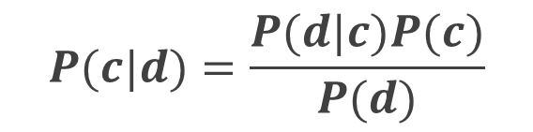
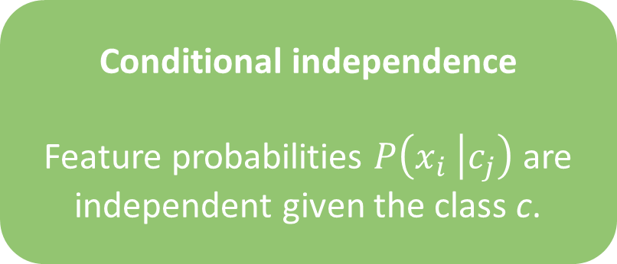
Word on Naïve Bayes for text classification
5
ML approach
Multinomial Naïve Bayes Independence Assumptions
Bag of Words assumption
Position does not matter
Conditional independence
Feature probabilities $P\left(x_{i} | c_{j}\right)$are independent given the class c.
$$P(c|d)=\frac{P(d|c)P(c)}{P(d)}$$
d – document; c - class

Slide 16
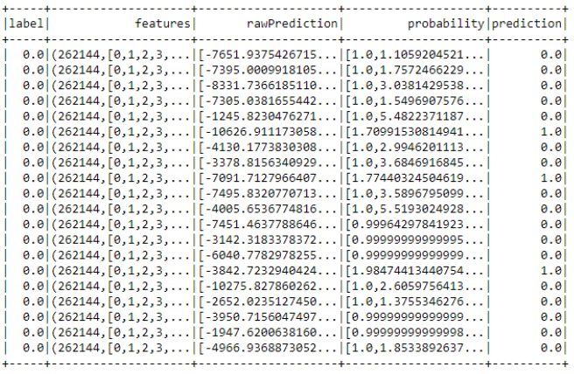
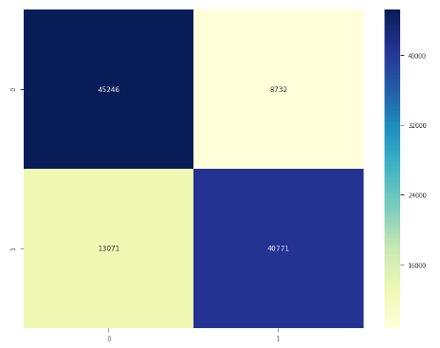
Modeling *
5
ML approach
Logistics regression, Naïve Bayes, SVM (with n-grams)
nb = NaiveBayes(smoothing=1.0, modelType="multinomial")
model = nb.fit(train)
predictions = model.transform(test)
evaluator = MulticlassClassificationEvaluator(
labelCol="label", predictionCol="prediction", metricName="accuracy")
accuracy = evaluator.evaluate(predictions)
Accuracy
~79%
only text features used
* Neutral sentiment removed from analysis for simple illustration and down-sampling performed on positive sentiment to balance working dataset.

Slide 17
Modeling *
5
ML approach
Logistics regression, Naïve Bayes, SVM (with n-grams)
ngram = NGram(inputCol = 'Lemmatized', outputCol = 'ngram', n = 2)
add_ngram = ngram.transform(stratified_data)
cv_ngram = CountVectorizer(inputCol='ngram', outputCol='tf_ngram’)
cvModel_ngram = cv_ngram.fit(add_ngram)
cv_df_ngram = cvModel_ngram.transform(add_ngram)
idf_ngram = IDF().setInputCol('tf_ngram').setOutputCol('tfidf_ngram’)
tfidfModel_ngram = idf_ngram.fit(cv_df_ngram)
tfidf_df_ngram = tfidfModel_ngram.transform(cv_df_ngram)
splits_ngram = tfidf_df_ngram.select(['tfidf_ngram’, 'label']).randomSplit([0.8,0.2] ,seed=123)
train_lb_ngram = splits_ngram[0].rdd.map(lambda row: LabeledPoint(row[1], MLLibVectors.fromML(row[0])))
test_lb_ngram = splits_ngram[1].rdd.map(lambda row: LabeledPoint(row[1], MLLibVectors.fromML(row[0])))
svm = SVMWithSGD.train(train_lb_ngram, numIterations=50, regParam=0.3)
Accuracy
~81%
only text features used
* Neutral sentiment removed from analysis for simple illustration and down-sampling performed on positive sentiment to balance working dataset.

Slide 18
Key takeaways and open points
6
Summary
Naïve Bayes – simple yet well performing model
Apache Spark performance in combination with AWS Spot Instances cost efficiency makes distributed computing easy and accessible for prototyping on big datasets.
Usage of sparse vector representation improve model training time.
Naïve Bayes – extensively used for documents classification and disease prediction. Relatively easy to implement and scale.
Use compute optimized instances to run your Spark cluster rather then general use machines.
Additional preprocessing will improve model in term of its accuracy. Use more information from metadata. Use stemming within text augmentation steps.
Extraction of the topics using LDA before fitting the model will reduce dimensionality and improve learning time.
Done
Could be done

Slide 19

Q&A

Slide 20




Thank you and let’s keep in touch ☺
datasciencenote.wordpress.com/about/
linkedin.com/in/sergiy-tkachuk-6aa008a1/
@TkachukSergiy
github.com/tkachuksergiy

